Slide 1
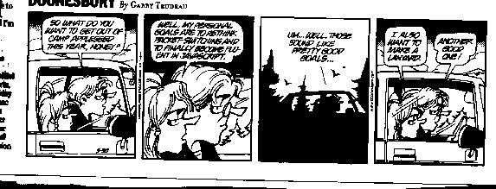
Transport Layer
Dr. Shelly Heller
sheller@gwu.edu

Slide 2
Recapturing where we were
Form pairs
What were we talking about last class – reliable transfer
Draw the FSM for receiver and Sender

Slide 3
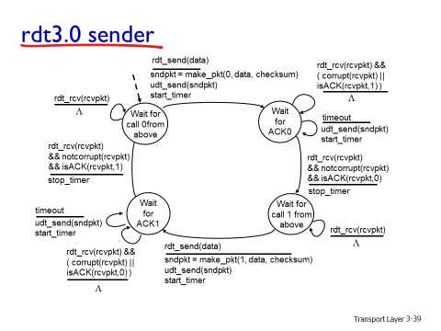
FSM for sender

Slide 4
FSM for receiver

Slide 5
Remember Performance of rdt3.0
rdt3.0 works, but performance stinks
example: 1 Gbps link, 15 ms e-e prop. delay, 1KB packet:
T
8kb/pkt
transmit
=
= 8 microsec
10⁹ b/sec
fraction of time
sender busy sending
8 msec
Utilization = U =
=
= 0.00027
30.008 msec
  1KB pkt every 30 msec -> 33kB/sec throughput over 1 Gbps link
  network protocol limits use of physical resources!
1KB is 8000bits

Slide 6

Pipelined protocols
Pipelining: sender allows multiple, “in-flight”, yet-to-be-acknowledged pkts
  range of sequence numbers must be increased
  buffering at sender and/or receiver
Two generic forms of pipelined protocols: go-Back-N, selective repeat

Slide 7
Go Back N
Sender
  Determine window size
  Send series, modulo window size
  Receive NACK, resend error plus subsequent packets
Receiver
  No error on packet, ack #
  Error? Send NACK, discard frame and all future ones until this one received correctly
  Possible Errors? Out of order, time out, error in frame

Slide 8
Cases – What could happen?
B has received and accepted segment_{i-1}
  A sends segment_{i} to B.
  A sets timer for segment_{i}
  Segment_{i} is invalid as detected by B. B discards segmentand takes no more action
Case a: A sends segment_{i+1.} B gets segment_{i+1} out of order, sends NACK _{I} A resends segment_{i} on
Case b: A doesn’t send anything, B receives nothing. Timer for segment_{i} expires. A sends ready note to B. B realizes it has to respond and says still expecting segment_{i} A sends segment_{i} OR A resends segment_{i} on time out

Slide 9

Go-Back-N
Sender:
k-bit seq # in pkt header (not a 0 or 1 as before)
“window” of up to N, consecutive unack’ed pkts allowed
ACK(n): ACKs all pkts up to, including seq # n - “cumulative ACK”
  may receive duplicate ACKs (see receiver)
timer for each in-flight pkt
timeout(n): retransmit pkt n and all higher seq # pkts in window

Slide 10
Sequence Number Space
K-bit sequence number has range 2^{k,} window size is 2^{k}-1
i.e. 3-bit space, 8 numbers, numbers 0,1,2,3,4,5,6,7
Send 0, get ack 1, send 1,2,3,4,5,6,7,0
Get ack 1 again – what does this mean?
Set window size to 2^{k}-1? (in this case 7)

Slide 11
The GBN App
The Go-Back-N demonstration
Another demonstration
Video Demonstration

Slide 12

GBN in action

Slide 13
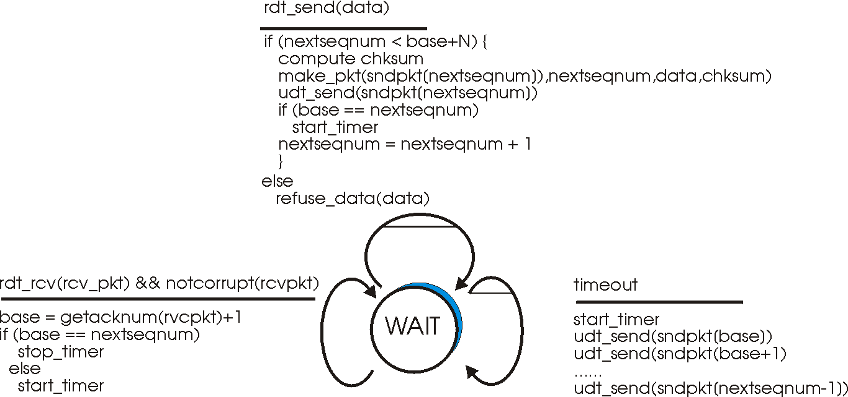
GBN: sender extended FSM
Received and Corrupt
Do nothing

Slide 14
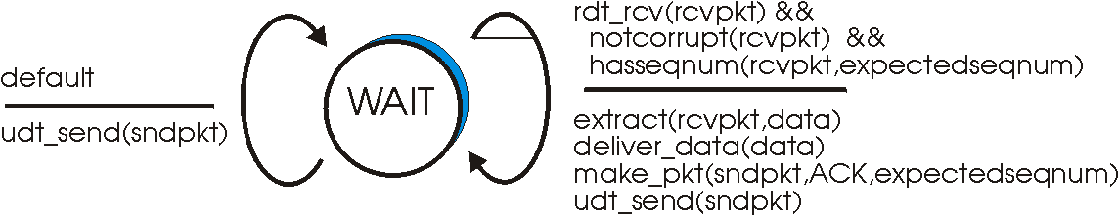
GBN: receiver extended FSM
receiver simple:
ACK-only: always send ACK for correctly-received pkt with highest in-order seq #
  may generate duplicate ACKs
  need only remember expectedseqnum
out-of-order pkt:
  discard (don’t buffer) -> no receiver buffering!
  ACK pkt with highest in-order seq #

Slide 15
Selective Repeat
receiver individually acknowledges all correctly received pkts
  buffers pkts, as needed, for eventual in-order delivery to upper layer
sender only resends pkts for which ACK not received
  sender timer for each unACKed pkt
sender window
  N consecutive seq #’s
  again limits seq #s of sent, unACKed pkts

Slide 16

Selective repeat: sender, receiver windows

Slide 17
Selective repeat
sender
receiver
pkt n in [rcvbase, rcvbase+N-1]
send ACK(n)
out-of-order: buffer
in-order: deliver (also deliver buffered, in-order pkts), advance window to next not-yet-received pkt
pkt n in [rcvbase-N,rcvbase-1]
ACK(n)
otherwise:
ignore
data from above :
if next available seq # in window, send pkt
timeout(n):
resend pkt n, restart timer
ACK(n) in [sendbase,sendbase+N]:
mark pkt n as received
if n smallest unACKed pkt, advance window base to next unACKed seq #

Slide 18
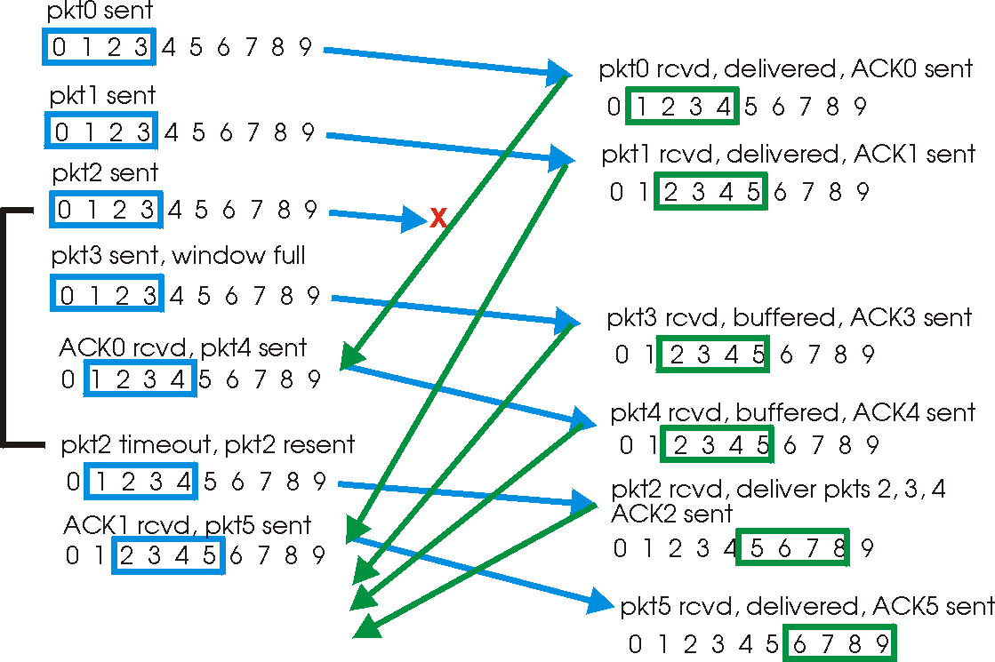
Selective repeat in action

Slide 19

Selective repeat: dilemma
Example:
seq #’s: 0, 1, 2, 3
window size=3
receiver sees no difference in two scenarios!
incorrectly passes duplicate data as new in (a)
Q: what relationship between seq # size and window size?
Demonstration

Slide 20
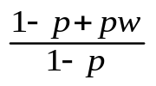

Comparisons Between Go-back-n and Selective Repeat
 | Go-back-n | Selective Repeat
data bandwidth: sender to receiver (avg. number of times a pkt is transmitted) | Less efficient | More efficient
ACK bandwidth (receiver to sender) | More efficient | Less Efficient
Relationship between M (the number of seq#) and W (window size) | M > W | M ≥ 2W
Buffer size at receiver | 1 | W
Complexity | Simpler | More complex
p: the loss rate of a packet; w: window size
Notes:
Small window size:
idle link (under-utilization).
Large window size:
Buffer space
Delay after loss
Ideal window size (assuming very low loss)
RTT =Round trip time
C = link capacity
window size = RTT * C
What happens with no loss?

Slide 21
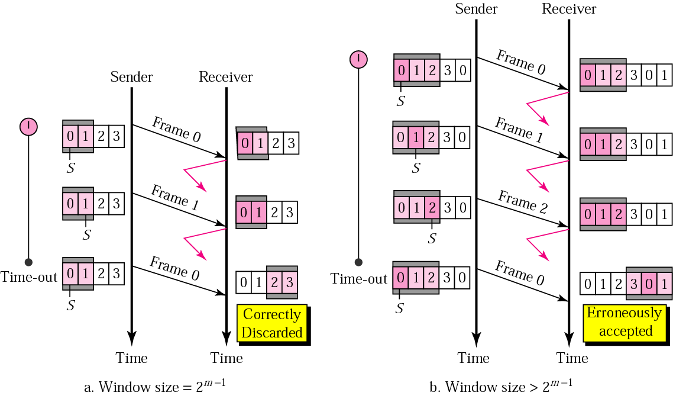
Window size

Slide 22
Selective repeat
sender
receiver
pkt n in [rcvbase, rcvbase+N-1]
send ACK(n)
out-of-order: buffer
in-order: deliver (also deliver buffered, in-order pkts), advance window to next not-yet-received pkt
pkt n in [rcvbase-N,rcvbase-1]
ACK(n)
otherwise:
ignore
data from above:
if next available seq # in window, send pkt
timeout(n):
resend pkt n, restart timer
ACK(n) in [sendbase,sendbase+N]:
mark pkt n as received
if n smallest unACKed pkt, advance window base to next unACKed seq #
Transport Layer
3-<number>

Slide 23

Selective repeat in action
sender window (N=4)
sender
receiver
0 1 2 3 4 5 6 7 8
send pkt0
send pkt1
send pkt2
send pkt3
(wait)
0 1 2 3 4 5 6 7 8
receive pkt0, send ack0
receive pkt1, send ack1
receive pkt3, buffer,
send ack3
0 1 2 3 4 5 6 7 8
X
0 1 2 3 4 5 6 7 8
loss
0 1 2 3 4 5 6 7 8
rcv ack0, send pkt4
rcv ack1, send pkt5
0 1 2 3 4 5 6 7 8
receive pkt4, buffer,
send ack4
record ack3 arrived
receive pkt5, buffer,
send ack5
pkt 2 timeout
0 1 2 3 4 5 6 7 8
send pkt2
0 1 2 3 4 5 6 7 8
record ack4 arrived
0 1 2 3 4 5 6 7 8
rcv pkt2; deliver pkt2,
pkt3, pkt4, pkt5; send ack2
record ack5 arrived
0 1 2 3 4 5 6 7 8
Q: what happens when ack2 arrives?
Transport Layer
3-<number>

Slide 24

Selective repeat: dilemma
sender window
(after receipt)
receiver window
(after receipt)
0 1 2 3 0 1 2
pkt0
example:
seq #’s: 0, 1, 2, 3
window size=3
0 1 2 3 0 1 2
pkt1
0 1 2 3 0 1 2
0 1 2 3 0 1 2
pkt2
0 1 2 3 0 1 2
0 1 2 3 0 1 2
0 1 2 3 0 1 2
pkt3
X
0 1 2 3 0 1 2
receiver sees no difference in two scenarios!
duplicate data accepted as new in (b)
Q: what relationship between seq # size and window size to avoid problem in (b)?
pkt0
will accept packet
with seq number 0
(a) no problem
receiver can’t see sender side.
receiver behavior identical in both cases!
something’s (very) wrong!
0 1 2 3 0 1 2
pkt0
0 1 2 3 0 1 2
pkt1
0 1 2 3 0 1 2
0 1 2 3 0 1 2
pkt2
0 1 2 3 0 1 2
X
0 1 2 3 0 1 2
X
timeout
retransmit pkt0
X
0 1 2 3 0 1 2
pkt0
Transport Layer
will accept packet
with seq number 0
3-<number>
(b) oops!

Slide 25
TCP: Overview RFCs: 793,1122,1323, 2018, 2581
point-to-point:
  one sender, one receiver
reliable, in-order byte steam:
  no “message boundaries”
pipelined:
  TCP congestion and flow control set window size
full duplex data:
  bi-directional data flow in same connection
  MSS: maximum segment size
connection-oriented:
  handshaking (exchange of control msgs) inits sender, receiver state before data exchange
flow controlled:
  sender will not overwhelm receiver
Transport Layer
3-<number>

Slide 26
TCP segment structure
32 bits
URG: urgent data
(generally not used)
counting
by bytes
of data
(not segments!)
source port #
dest port #
sequence number
ACK: ACK #
valid
acknowledgement number
head
len
not
used
U
receive window
A
PSH: push data now
(generally not used)
P
R
S
F
# bytes
rcvr willing
to accept
checksum
Urg data pointer
RST, SYN, FIN:
connection estab
(setup, teardown
commands)
options (variable length)
application
data
(variable length)
Internet
checksum
(as in UDP)
Transport Layer
3-<number>

Slide 27
Flow Control

Slide 28
TCP seq. numbers, ACKs
outgoing segment from sender
sequence numbers:
  byte stream “number” of first byte in segment’s data
acknowledgements:
  seq # of next byte expected from other side
  cumulative ACK
Q: how receiver handles out-of-order segments
  A: TCP spec doesn’t say, - up to implementor
source port #
dest port #
sequence number
acknowledgement number
rwnd
checksum
urg pointer
window size
N
  sender sequence number space
sent
ACKed
sent, not-yet ACKed
(“in-flight”)
usable
but not
yet sent
not
usable
incoming segment to sender
source port #
dest port #
sequence number
acknowledgement number
A
rwnd
Transport Layer
checksum
urg pointer
3-<number>

Slide 29

TCP seq. numbers, ACKs
Host A
Host B
User
types
‘C’
Seq=42, ACK=79, data = ‘C’
host ACKs
receipt of
‘C’, echoes
back ‘C’
Seq=79, ACK=43, data = ‘C’
host ACKs
receipt
of echoed
‘C’
Seq=43, ACK=80
simple telnet scenario
Transport Layer
3-<number>

Slide 30
TCP round trip time, timeout
Q: how to set TCP timeout value?
longer than RTT
  but RTT varies
too short: premature timeout, unnecessary retransmissions
too long: slow reaction to segment loss
Q: how to estimate RTT?
SampleRTT: measured time from segment transmission until ACK receipt
  ignore retransmissions
SampleRTT will vary, want estimated RTT “smoother”
  average several recent measurements, not just current SampleRTT
Transport Layer
3-<number>

Slide 31

TCP round trip time, timeout
EstimatedRTT = (1- α)*EstimatedRTT + α*SampleRTT
exponential weighted moving average
influence of past sample decreases exponentially fast
typical value: α = 0.125
RTT: gaia.cs.umass.edu to fantasia.eurecom.fr
RTT (milliseconds)
sampleRTT
EstimatedRTT
Transport Layer
3-<number>
time (seconds)

Slide 32

TCP round trip time, timeout
timeout interval: EstimatedRTT plus “safety margin”
  large variation in EstimatedRTT -> larger safety margin
estimate SampleRTT deviation from EstimatedRTT:
DevRTT = (1-β)*DevRTT +
β*|SampleRTT-EstimatedRTT|
(typically, β = 0.25)
TimeoutInterval = EstimatedRTT + 4*DevRTT
estimated RTT
“safety margin”
* Check out the online interactive exercises for more examples: http://gaia.cs.umass.edu/kurose_ross/interactive/
Transport Layer
3-<number>

Slide 33
TCP reliable data transfer
TCP creates rdt service on top of IP’s unreliable service
  pipelined segments
  cumulative acks
  single retransmission timer
retransmissions triggered by:
  timeout events
  duplicate acks
let’s initially consider simplified TCP sender:
  ignore duplicate acks
  ignore flow control, congestion control
Transport Layer
3-<number>

Slide 34
TCP sender events:
data rcvd from app:
create segment with seq #
seq # is byte-stream number of first data byte in segment
start timer if not already running
  think of timer as for oldest unacked segment
  expiration interval: TimeOutInterval
timeout:
retransmit segment that caused timeout
restart timer
ack rcvd:
if ack acknowledges previously unacked segments
  update what is known to be ACKed
  start timer if there are still unacked segments
Transport Layer
3-<number>

Slide 35
TCP sender (simplified)
data received from application above
create segment, seq. #: NextSeqNum
pass segment to IP (i.e., “send”)
NextSeqNum = NextSeqNum + length(data)
if (timer currently not running)
start timer
Λ
NextSeqNum = InitialSeqNum
SendBase = InitialSeqNum
wait
for
event
timeout
retransmit not-yet-acked segment with smallest seq. #
start timer
ACK received, with ACK field value y
if (y > SendBase) {
SendBase = y
/* SendBase–1: last cumulatively ACKed byte */
if (there are currently not-yet-acked segments)
start timer
else stop timer
}
Transport Layer
3-<number>

Slide 36
TCP: retransmission scenarios
Host A
Host B
Host A
Host B
SendBase=92
Seq=92, 8 bytes of data
Seq=92, 8 bytes of data
timeout
timeout
Seq=100, 20 bytes of data
ACK=100
X
ACK=100
ACK=120
Seq=92, 8 bytes of data
Seq=92, 8
bytes of data
SendBase=100
SendBase=120
ACK=100
ACK=120
SendBase=120
lost ACK scenario
premature timeout
Transport Layer
3-<number>

Slide 37
TCP: retransmission scenarios
Host A
Host B
Seq=92, 8 bytes of data
Seq=100, 20 bytes of data
timeout
ACK=100
X
ACK=120
Seq=120, 15 bytes of data
cumulative ACK
Transport Layer
3-<number>

Slide 38
TCP ACK generation [RFC 1122, RFC 2581]
event at receiver
arrival of in-order segment with
expected seq #. All data up to
expected seq # already ACKed
arrival of in-order segment with
expected seq #. One other
segment has ACK pending
arrival of out-of-order segment
higher-than-expect seq. # .
Gap detected
arrival of segment that
partially or completely fills gap
TCP receiver action
delayed ACK. Wait up to 500ms
for next segment. If no next segment,
send ACK
immediately send single cumulative
ACK, ACKing both in-order segments
immediately send duplicate ACK,
indicating seq. # of next expected byte
immediate send ACK, provided that
segment starts at lower end of gap
Transport Layer
3-<number>

Slide 39
TCP fast retransmit
time-out period often relatively long:
  long delay before resending lost packet
detect lost segments via duplicate ACKs.
  sender often sends many segments back-to-back
  if segment is lost, there will likely be many duplicate ACKs.
TCP fast retransmit
if sender receives 3 ACKs for same data
(“triple duplicate ACKs”), resend unacked segment with smallest seq #
  likely that unacked segment lost, so don’t wait for timeout
(“triple duplicate ACKs”),
Transport Layer
3-<number>

Slide 40
TCP fast retransmit
Host A
Host B
Seq=92, 8 bytes of data
Seq=100, 20 bytes of data
X
ACK=100
timeout
ACK=100
ACK=100
ACK=100
Seq=100, 20 bytes of data
fast retransmit after sender
receipt of triple duplicate ACK
Transport Layer
3-<number>

Slide 41
TCP flow control
application
process
application may
remove data from
TCP socket buffers ….
application
TCP socket
receiver buffers
OS
… slower than TCP
receiver is delivering
(sender is sending)
TCP
code
flow control
IP
code
receiver controls sender, so sender won’t overflow receiver’s buffer by transmitting too much, too fast
from sender
receiver protocol stack
Transport Layer
3-<number>

Slide 42
TCP flow control
receiver “advertises” free buffer space by including rwnd value in TCP header of receiver-to-sender segments
  RcvBuffer size set via socket options (typical default is 4096 bytes)
  many operating systems autoadjust RcvBuffer
sender limits amount of unacked (“in-flight”) data to receiver’s rwnd value
guarantees receive buffer will not overflow
to application process
RcvBuffer
buffered data
rwnd
free buffer space
TCP segment payloads
receiver-side buffering
Transport Layer
3-<number>

Slide 43
Connection Management
before exchanging data, sender/receiver “handshake”:
agree to establish connection (each knowing the other willing to establish connection)
agree on connection parameters
application
application
connection state: ESTAB
connection variables:
  seq # client-to-server
  server-to-client
  rcvBuffer size
  at server,client
connection state: ESTAB
connection Variables:
  seq # client-to-server
  server-to-client
  rcvBuffer size
  at server,client
network
network
Socket clientSocket =
newSocket("hostname","port number");
Socket connectionSocket = welcomeSocket.accept();
Transport Layer
3-<number>

Slide 44



Agreeing to establish a connection
2-way handshake:
Q: will 2-way handshake always work in network?
variable delays
retransmitted messages (e.g. req_conn(x)) due to message loss
message reordering
can’t “see” other side
Let’s talk
ESTAB
OK
ESTAB
choose x
req_conn(x)
ESTAB
acc_conn(x)
ESTAB
Transport Layer
3-<number>

Slide 45
Agreeing to establish a connection
2-way handshake failure scenarios:
choose x
choose x
req_conn(x)
req_conn(x)
ESTAB
ESTAB
retransmit
req_conn(x)
acc_conn(x)
retransmit
req_conn(x)
acc_conn(x)
ESTAB
ESTAB
data(x+1)
accept
data(x+1)
req_conn(x)
retransmit
data(x+1)
connection
x completes
connection
x completes
client terminates
server
forgets x
client terminates
server
forgets x
req_conn(x)
ESTAB
data(x+1)
ESTAB
half open connection!
(no client!)
accept
data(x+1)
Transport Layer
3-<number>

Slide 46
TCP 3-way handshake
client state
server state
LISTEN
LISTEN
choose init seq num, x
send TCP SYN msg
SYNSENT
SYNbit=1, Seq=x
choose init seq num, y
send TCP SYNACK
msg, acking SYN
SYN RCVD
SYNbit=1, Seq=y
ACKbit=1; ACKnum=x+1
received SYNACK(x)
indicates server is live;
send ACK for SYNACK;
this segment may contain
client-to-server data
ESTAB
ACKbit=1, ACKnum=y+1
received ACK(y)
indicates client is live
ESTAB
Transport Layer
3-<number>

Slide 47
TCP 3-way handshake: FSM
closed
Socket connectionSocket = welcomeSocket.accept();
Λ
Socket clientSocket =
newSocket("hostname","port number");
SYN(x)
SYNACK(seq=y,ACKnum=x+1)
create new socket for
communication back to client
listen
SYN(seq=x)
SYN
rcvd
SYN
sent
SYNACK(seq=y,ACKnum=x+1)
ACK(ACKnum=y+1)
ESTAB
ACK(ACKnum=y+1)
Λ
Transport Layer
3-<number>

Slide 48
TCP: closing a connection
client, server each close their side of connection
  send TCP segment with FIN bit = 1
respond to received FIN with ACK
  on receiving FIN, ACK can be combined with own FIN
simultaneous FIN exchanges can be handled
Transport Layer
3-<number>

Slide 49
TCP: closing a connection
client state
server state
ESTAB
ESTAB
clientSocket.close()
FIN_WAIT_1
can no longer
send but can
receive data
FINbit=1, seq=x
CLOSE_WAIT
ACKbit=1; ACKnum=x+1
can still
send data
FIN_WAIT_2
wait for server
close
LAST_ACK
FINbit=1, seq=y
TIMED_WAIT
can no longer
send data
ACKbit=1; ACKnum=y+1
timed wait
for 2*max
segment lifetime
CLOSED
CLOSED
Transport Layer
3-<number>

Slide 50
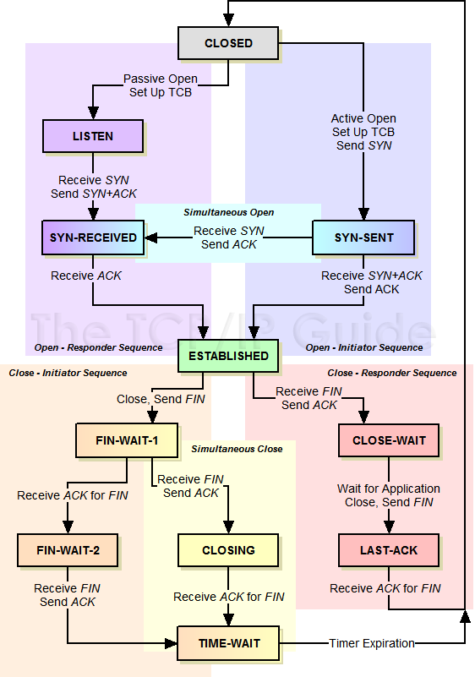
Your Turn TCP Handshake FSM
Form pairs: Work out the FSM for the TCP
handshake

Slide 51
Principles of congestion control
congestion:
informally: “too many sources sending too much data too fast for network to handle”
different from flow control!
manifestations:
  lost packets (buffer overflow at routers)
  long delays (queueing in router buffers)
a top-10 problem!
Transport Layer
3-<number>

Slide 52

Causes/costs of congestion: scenario 1
original data: λ_{in}
throughput: λ_{out}
two senders, two receivers
one router, infinite buffers
output link capacity: R
no retransmission
Host A
unlimited shared output link buffers
Host B
R/2
λ_{out}
delay
λ_{in}
R/2
λ_{in}
R/2
maximum per-connection throughput: R/2
large delays as arrival rate, λ_{in}, approaches capacity
Transport Layer
3-<number>

Slide 53
Causes/costs of congestion: scenario 2
one router, finite buffers
sender retransmission of timed-out packet
  application-layer input = application-layer output: λ_{in} = λ_{out}
  transport-layer input includes retransmissions : λ_{in} λ_{in}
‘
λ_{in} : original data
λ'_{in}: original data, plus retransmitted data
λ_{out}
Host A
finite shared output link buffers
Host B
Transport Layer
3-<number>

Slide 54
Causes/costs of congestion: scenario 2
R/2
idealization: perfect knowledge
sender sends only when router buffers available
λ_{out}
λ_{in}
R/2
λ_{in} : original data
copy
λ'_{in}: original data, plus retransmitted data
λ_{out}
A
free buffer space!
finite shared output link buffers
Host B
Transport Layer
3-<number>

Slide 55

Causes/costs of congestion: scenario 2
Idealization: known loss packets can be lost, dropped at router due to full buffers
sender only resends if packet known to be lost
λ_{in} : original data
copy
λ'_{in}: original data, plus retransmitted data
λ_{out}
A
no buffer space!
Host B
Transport Layer
3-<number>

Slide 56
Causes/costs of congestion: scenario 2
Idealization: known loss packets can be lost, dropped at router due to full buffers
sender only resends if packet known to be lost
R/2
when sending at R/2, some packets are retransmissions but asymptotic goodput is still R/2 (why?)
λ_{out}
λ_{in}
R/2
λ_{in} : original data
λ'_{in}: original data, plus retransmitted data
λ_{out}
A
free buffer space!
Host B
Transport Layer
3-<number>

Slide 57


Causes/costs of congestion: scenario 2
Realistic: duplicates
packets can be lost, dropped at router due to full buffers
sender times out prematurely, sending two copies, both of which are delivered
R/2
when sending at R/2, some packets are retransmissions including duplicated that are delivered!
λ_{out}
λ_{in}
R/2
λ_{in}
copy
λ'_{in}
λ_{out}
timeout
A
free buffer space!
Host B
Transport Layer
3-<number>

Slide 58
Causes/costs of congestion: scenario 2
Realistic: duplicates
packets can be lost, dropped at router due to full buffers
sender times out prematurely, sending two copies, both of which are delivered
R/2
when sending at R/2, some packets are retransmissions including duplicated that are delivered!
λ_{out}
λ_{in}
R/2
“costs” of congestion:
more work (retrans) for given “goodput”
unneeded retransmissions: link carries multiple copies of pkt
  decreasing goodput
Transport Layer
3-<number>

Slide 59
Causes/costs of congestion: scenario 3
Q: what happens as λ_{in} and λ_{in}’ increase ?
four senders
multihop paths
timeout/retransmit
A: as red λ_{in}’ increases, all arriving blue pkts at upper queue are dropped, blue throughput  0
Host A
λ_{in} : original data
λ_{out}
Host B
λ'_{in}: original data, plus retransmitted data
finite shared output link buffers
Host D
Host C
Transport Layer
3-<number>

Slide 60
Causes/costs of congestion: scenario 3
C/2
λ_{out}
λ_{in}’
C/2
another “cost” of congestion:
when packet dropped, any “upstream transmission capacity used for that packet was wasted!
Transport Layer
3-<number>

Slide 61
TCP congestion control: additive increase multiplicative decrease
approach: sender increases transmission rate (window size), probing for usable bandwidth, until loss occurs
  additive increase: increase cwnd by 1 MSS every RTT until loss detected
  multiplicative decrease: cut cwnd in half after loss
additively increase window size …
…. until loss occurs (then cut window in half)
AIMD saw tooth
behavior: probing
for bandwidth
cwnd: TCP sender
congestion window size
time
Transport Layer
3-<number>

Slide 62
TCP Congestion Control: details
sender sequence number space
cwnd
TCP sending rate:
roughly: send cwnd bytes, wait RTT for ACKS, then send more bytes
last byte
ACKed
last byte sent
sent, not-yet ACKed
(“in-flight”)
sender limits transmission:
cwnd is dynamic, function of perceived network congestion
<
cwnd
cwnd
LastByteSent-LastByteAcked
rate
~
bytes/sec
~
RTT
Transport Layer
3-<number>

Slide 63
TCP Slow Start
Host A
Host B
when connection begins, increase rate exponentially until first loss event:
  initially cwnd = 1 MSS
  double cwnd every RTT
  done by incrementing cwnd for every ACK received
summary: initial rate is slow but ramps up exponentially fast
one segment
RTT
two segments
four segments
time
Transport Layer
3-<number>

Slide 64
TCP: detecting, reacting to loss
loss indicated by timeout:
  cwnd set to 1 MSS;
  window then grows exponentially (as in slow start) to threshold, then grows linearly
loss indicated by 3 duplicate ACKs: TCP RENO
  dup ACKs indicate network capable of delivering some segments
  cwnd is cut in half window then grows linearly
TCP Tahoe always sets cwnd to 1 (timeout or 3 duplicate acks)
Transport Layer
3-<number>

Slide 65

TCP: switching from slow start to CA
Q: when should the exponential increase switch to linear?
A: when cwnd gets to 1/2 of its value before timeout.
Implementation:
variable ssthresh
on loss event, ssthresh is set to 1/2 of cwnd just before loss event
Transport Layer
3-<number>

Slide 66

Summary: TCP Congestion Control
New
ACK!
New
ACK!
.
duplicate ACK
new ACK
dupACKcount++
new ACK
cwnd = cwnd + MSS (MSS/cwnd)
dupACKcount = 0
transmit new segment(s), as allowed
cwnd = cwnd+MSS
dupACKcount = 0
transmit new segment(s), as allowed
Λ
cwnd = 1 MSS
ssthresh = 64 KB
dupACKcount = 0
cwnd > ssthresh
slow
start
Λ
congestion
avoidance
timeout
ssthresh = cwnd/2
cwnd = 1 MSS
dupACKcount = 0
retransmit missing segment
duplicate ACK
timeout
dupACKcount++
ssthresh = cwnd/2
cwnd = 1 MSS
dupACKcount = 0
retransmit missing segment
timeout
New
ACK!
ssthresh = cwnd/2
cwnd = 1
dupACKcount = 0
retransmit missing segment
New ACK
dupACKcount == 3
cwnd = ssthresh
dupACKcount = 0
dupACKcount == 3
ssthresh= cwnd/2
cwnd = ssthresh + 3
retransmit missing segment
ssthresh= cwnd/2
cwnd = ssthresh + 3
retransmit missing segment
fast
recovery
duplicate ACK
cwnd = cwnd + MSS
transmit new segment(s), as allowed
Transport Layer
3-<number>

Slide 67
TCP throughput
avg. TCP thruput as function of window size, RTT?
  ignore slow start, assume always data to send
W: window size (measured in bytes) where loss occurs
  avg. window size (# in-flight bytes) is ¾ W
  avg. thruput is 3/4W per RTT
avg TCP thruput =
3
W
4
RTT
bytes/sec
W
W/2
Transport Layer
3-<number>

Slide 68
TCP Futures: TCP over “long, fat pipes”
example: 1500 byte segments, 100ms RTT, want 10 Gbps throughput
requires W = 83,333 in-flight segments
throughput in terms of segment loss probability, L [Mathis 1997]:
  ➜ to achieve 10 Gbps throughput, need a loss rate of L = 2·10⁻¹⁰ – a very small loss rate!
new versions of TCP for high-speed
1.22
.
MSS
TCP throughput =
RTT
L
Transport Layer
3-<number>

Slide 69
TCP Fairness
fairness goal: if K TCP sessions share same bottleneck link of bandwidth R, each should have average rate of R/K
TCP connection 1
bottleneck
router
capacity R
TCP connection 2
Transport Layer
3-<number>

Slide 70
Why is TCP fair?
two competing sessions:
additive increase gives slope of 1, as throughout increases
multiplicative decrease decreases throughput proportionally
R
equal bandwidth share
loss: decrease window by factor of 2
congestion avoidance: additive increase
Connection 2 throughput
loss: decrease window by factor of 2
congestion avoidance: additive increase
Connection 1 throughput
R
Transport Layer
3-<number>

Slide 71
Fairness (more)
Fairness and UDP
multimedia apps often do not use TCP
  do not want rate throttled by congestion control
instead use UDP:
  send audio/video at constant rate, tolerate packet loss
Fairness, parallel TCP connections
application can open multiple parallel connections between two hosts
web browsers do this
e.g., link of rate R with 9 existing connections:
  new app asks for 1 TCP, gets rate R/10
  new app asks for 11 TCPs, gets R/2
Transport Layer
3-<number>

Slide 72
Explicit Congestion Notification (ECN)
network-assisted congestion control:
two bits in IP header (ToS field) marked by network router to indicate congestion
congestion indication carried to receiving host
receiver (seeing congestion indication in IP datagram) ) sets ECE bit on receiver-to-sender ACK segment to notify sender of congestion
source
TCP ACK segment
destination
application
transport
network
link
physical
ECE=1
application
transport
network
link
physical
ECN=11
ECN=00
ECN=11
IP datagram
Transport Layer
3-<number>

Slide 73
Chapter 3: summary
principles behind transport layer services:
  multiplexing, demultiplexing
  reliable data transfer
  flow control
  congestion control
instantiation, implementation in the Internet
  UDP
  TCP
next:
leaving the network “edge” (application, transport layers)
into the network “core”
two network layer chapters:
  data plane
  control plane
Transport Layer
3-<number>

